Slide 1
Cloudflare web encryption

Slide 2

What is Cloudflare
Cloudflare is an internet security company
They provide companies with SSL/TLS encryption – protects billions of web requests daily by encrypting the data that’s transferred between the user’s browser and a server
For encryption to be secure we need unpredictable encryption keys so that attackers can’t access encrypted data

Slide 3
Computers and randomness
They can’t create randomness – only simulate it
This is because computers are deterministic
So an output of a calculation will be the same when given the same input
Random values from a computer can be predictable
The goal is to get as close to true randomness as possible

Slide 4
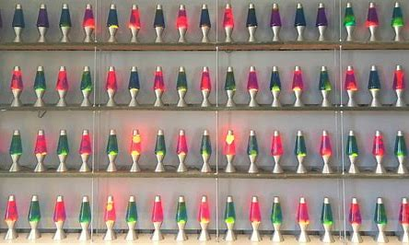
Lava lamps
The “lava” in lava lamps moves randomly – doesn’t take the same shape twice
About 100 lava lamps on the wall
The camera takes photos of the lava lamps at regular intervals
Images stored as a series numbers – each pixel has its own numerical value
This is used as a starting point to create encryption keys – a cryptographic seed

Slide 5
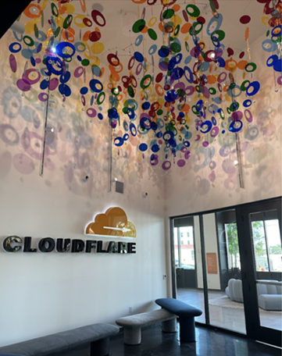
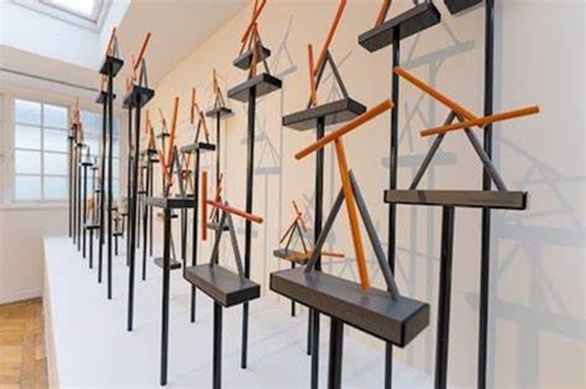
The whole process is also done in the London office and the Austin Texas office with different sources of entropy.
In Austin they use rainbow mobiles
In London they use pendulums
All of these sources of entropy including more are combined and mixed into the “global entropy pool”

